Slide 1
Customer Retention Case Study
Submitted by: OLIVER RAMAN

Slide 2
Problem Statement.
Customer satisfaction has emerged as one of the most important factors that guarantee the success of online store; it has been posited as a key stimulant of purchase, repurchase intentions and customer loyalty. A comprehensive review of the literature, theories and models have been carried out to propose the models for customer activation and customer retention.
Five major factors that contributed to the success of an e-commerce store have been identified as: service quality, system quality, information quality, trust and net benefit. The research furthermore investigated the factors that influence the online customers repeat purchase intention. The combination of both utilitarian value and hedonistic values are needed to affect the repeat purchase intention (loyalty) positively.
The data is collected from the Indian online shoppers. Results indicate the e-retail success factors, which are very much critical for customer satisfaction.

Slide 3
Customer Retention.
Customer retention refers to a company's ability to turn customers into repeat buyers and prevent them from switching to a competitor. It indicates whether your product and the quality of your service are pleasing to your existing customers.
Customer Retention is the lifeblood of most subscription-based companies and service providers.
The goal is to build a long lasting relationship between the brand and the brand’s consumers.

Slide 4
Exploratory Data Analysis Steps.
Step 1: Checking the Number of rows and columns.
Step 2: Checking the Null Values present in each column (if any) & visualizing the null values.
Step 3: Checking the Unique values present in each column.
Step 4: Checking the Data Types of each column.
Step 5: Checking the Column names.
Step 6: Checking the Value counts of each column.
Step 7: Checking the Missing values in all columns.
Step 8: Checking the number of numerical columns/variables present in the dataset.
Step 9: Checking the number of discrete columns/variables present in the dataset.

Slide 5
Data Visualization
The dataset contained 70 categorical columns and 1 numerical column. A bivariate analysis is done using factorplot - count for better understanding of the features present in the data set.

Slide 6
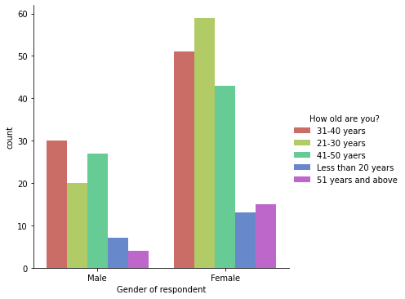
Bi-Variate Analysis Graphs.
Females are doing more shopping compared to males. Also, females with age group 21-30 and men of age group 31-40 are shopping more than the other age groups.

Slide 7
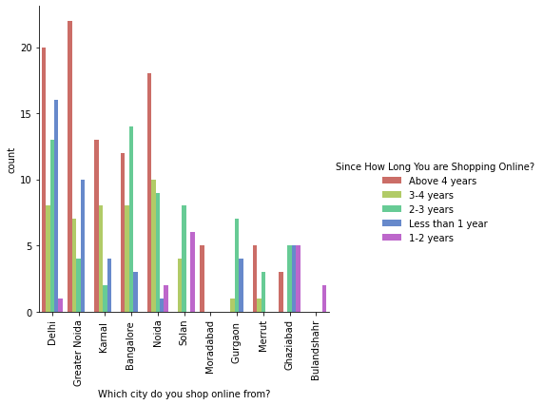
Bi-Variate Analysis Graphs.
As we can see here more customers are in Greater Noida and they have above 4 years of online shopping experience.

Slide 8
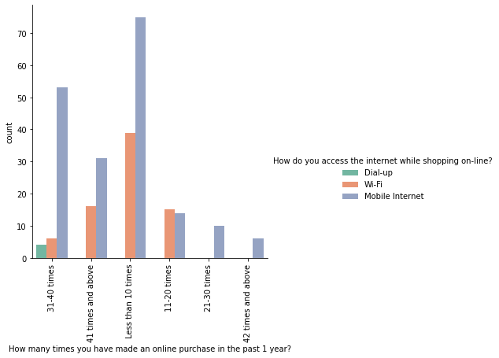
Bi-Variate Analysis Graphs.
In all the frequencies of online purchase in past 1 year, the usage of mobile internet for internet access is high. The most number of online purchases in a year was found to be less than 10 times.

Slide 9
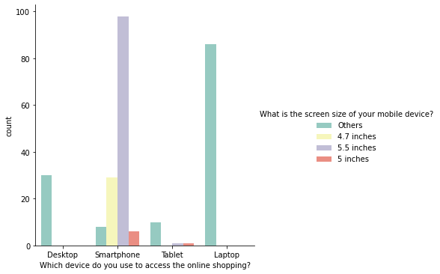
Bi-Variate Analysis Graphs.
Most the respondents were smartphone users with maximum screen size of 5.5 inches. Also, other devices, the screen size is not specified.

Slide 10
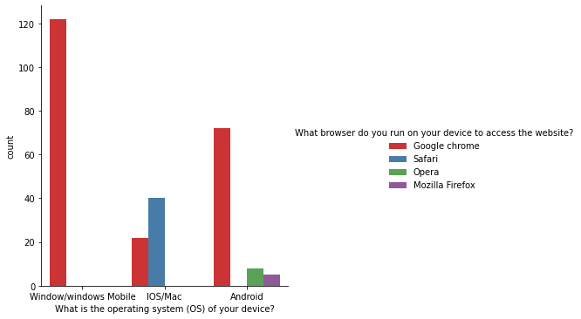
Bi-Variate Analysis Graphs.
Most of the respondents are windows users and use Google Chrome as their preferred browser. IOS/Mac users use Safari as their browser.

Slide 11
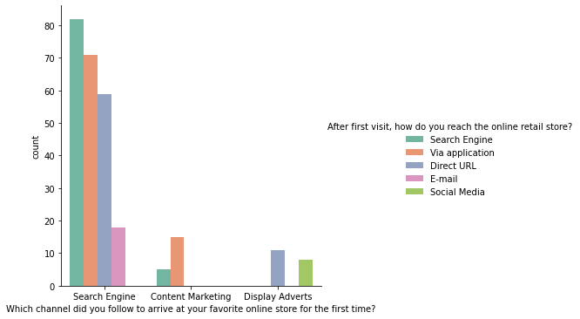
Bi-Variate Analysis Graphs.
Most of the respondents used Search Engine to visit the online store for first time and after the first visit, they reached the online store by using search engines again. So search engines are good to get more number of customers.

Slide 12
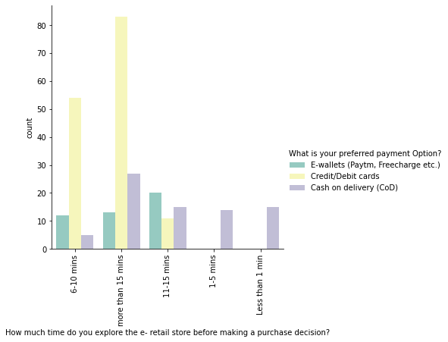
Bi-Variate Analysis Graphs.
Most of the respondents explored the e-retail store for more than 15 mins before making a purchase decision and maximum number of respondents used credit/debit cards as their payment option.

Slide 13
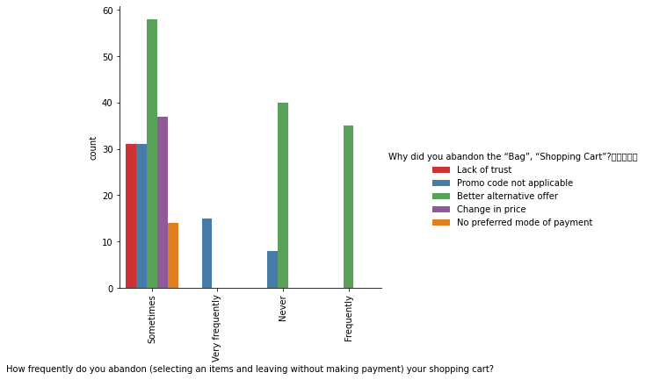
Bi-Variate Analysis Graphs.
Maximum no of respondents abandon their shopping cart: 'sometimes' and the main reason for abandoning is 'better alternative offer'.

Slide 14
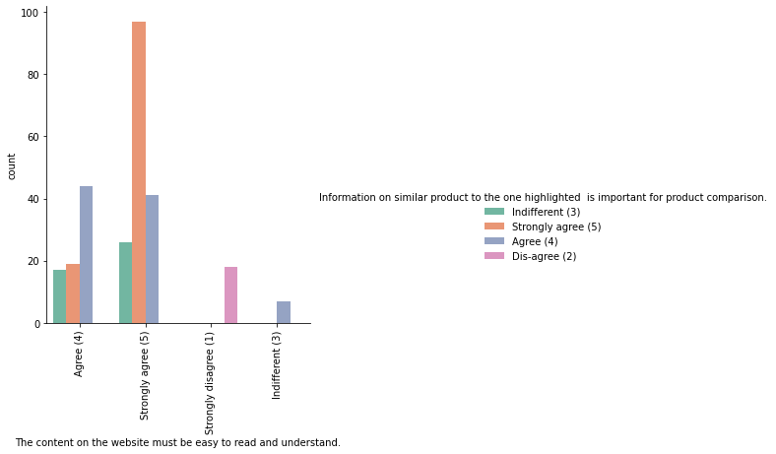
Bi-Variate Analysis Graphs.
Most of our respondents strongly agree that the content on the website must be easy to read and understand and also the information on similar products must be highlighted.

Slide 15
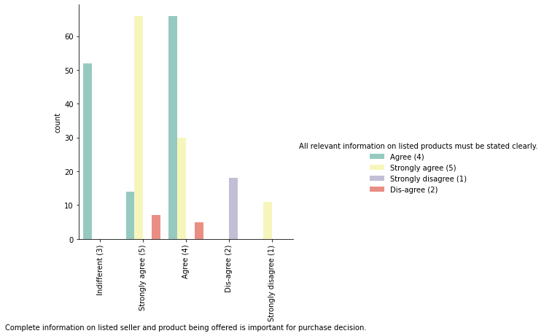
Bi-Variate Analysis Graphs.
Most of the respondents agree that complete information on the seller and all relevant information on products listed is important for purchase decision.

Slide 16
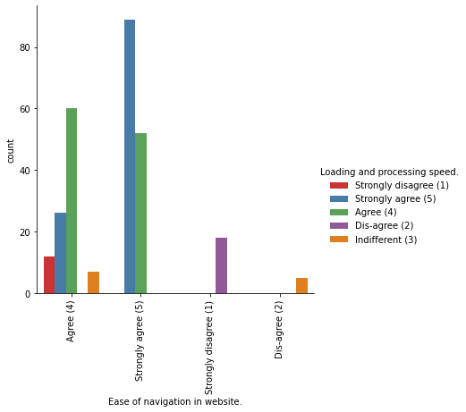
Bi-Variate Analysis Graphs.
Most of the respondents Agree to the easy navigation in the website & the loading and processing speed.

Slide 17
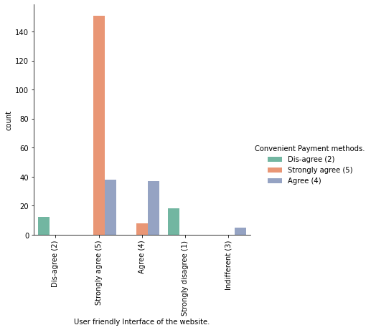
Bi-Variate Analysis Graphs.
Most respondents strongly agreed that the website had a User Friendly Interface and had Convenient Payment Methods.

Slide 18
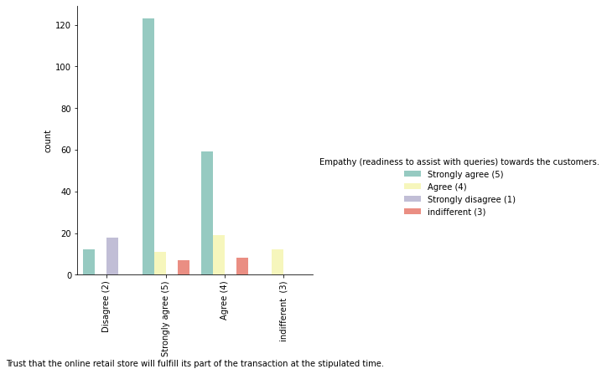
Bi-Variate Analysis Graphs.
Most Respondents agree that they trusted the online retail store would fulfill its part of the transaction in the stipulated time. Also they agree that the online retail store had empathy towards the customers.

Slide 19
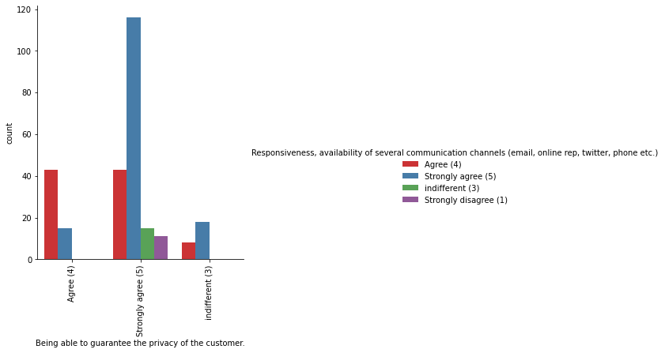
Bi-Variate Analysis Graphs.
Most of the respondents want to have the guarantee of privacy for the customer and they also wish to have responsiveness, availability of several communication channels.

Slide 20
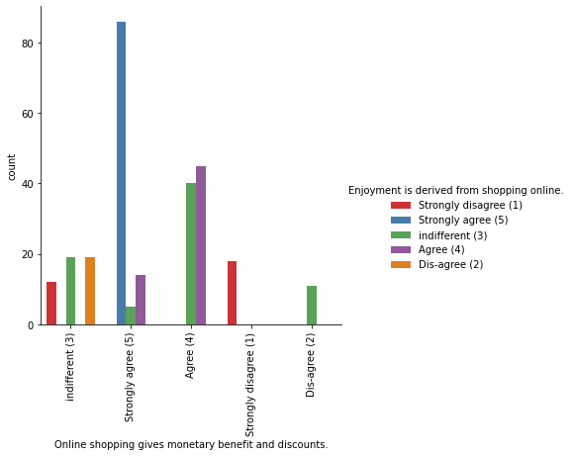
Bi-Variate Analysis Graphs.
Maximum number of respondents agree that “Enjoyment is derived from online shopping”, also that online shopping gives monetary benefits and discounts.

Slide 21
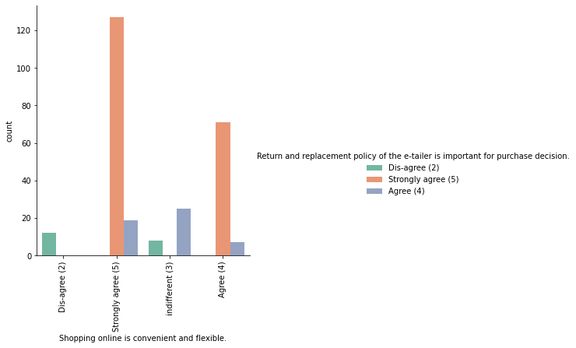
Bi-Variate Analysis Graphs.
Most respondents agree that shopping online is convenient and flexible and they also agree that return and replacement policy of the e-tailer is important for purchase decision.

Slide 22
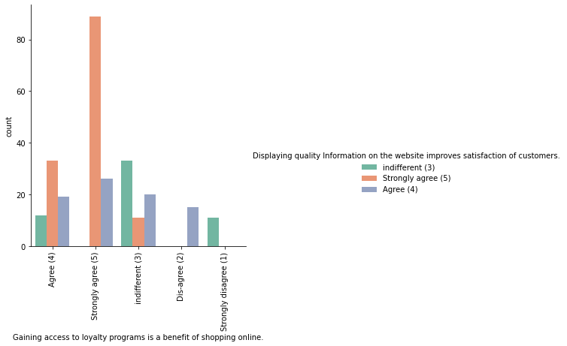
Bi-Variate Analysis Graphs.
Most respondents agree with 'Gaining access to loyalty programs is a benefit of shopping online' and they also agree that displaying quality information on the website improves satisfaction of customers.

Slide 23
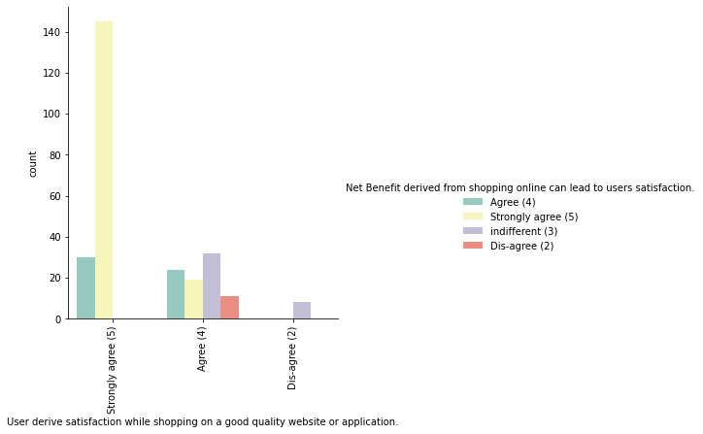
Bi-Variate Analysis Graphs.
Most respondents agree that users derive satisfaction while shopping on a good quality website or application. Also, net benefit derived from shopping online can lead to users satisfaction.

Slide 24
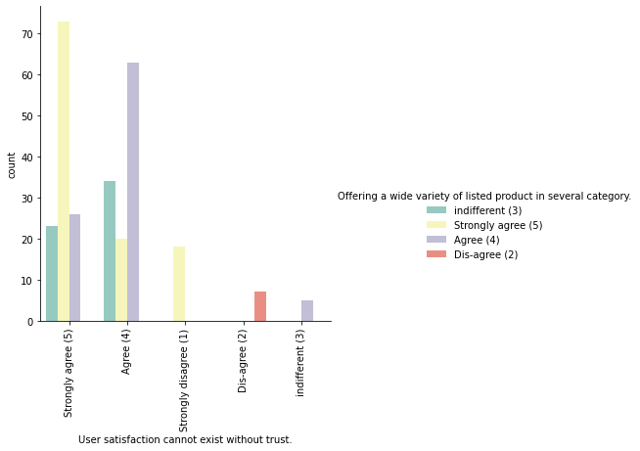
Bi-Variate Analysis Graphs.
Most of the respondents agree and strongly agree that user satisfaction cannot exist without trust and also that there must be a wide variety of listed product in several categories.

Slide 25
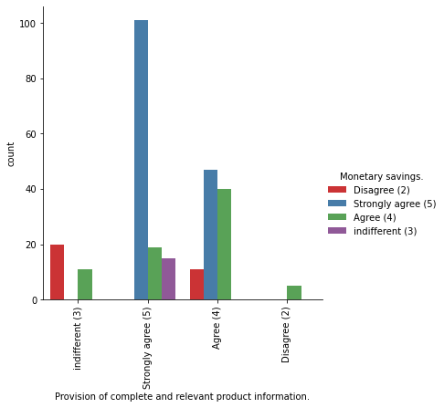
Bi-Variate Analysis Graphs.
Most respondents agree and strongly agree to "provision of complete and relevant product information" and they also agree to have monetary savings.

Slide 26
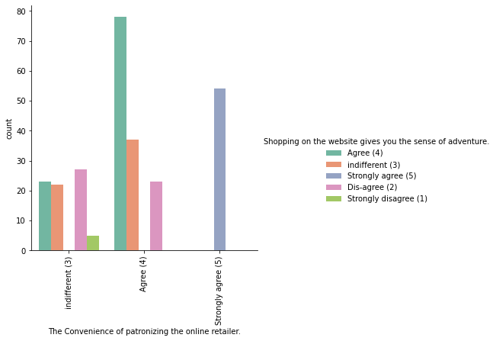
Bi-Variate Analysis Graphs.
Most respondents agree to having the convenience of patronizing the online retailer and they also agree that shopping on website gives us the sense of adventure.

Slide 27
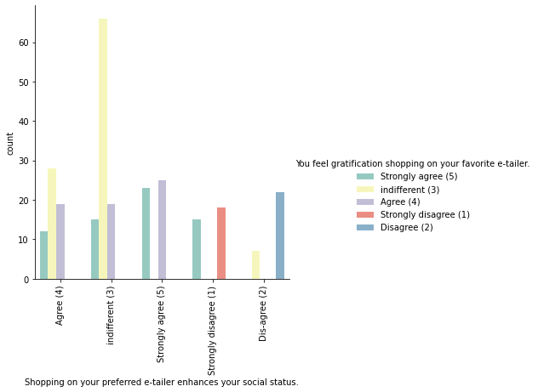
Bi-Variate Analysis Graphs.
Most respondents agrees that we feel gratification shopping on there favorite e-tailer and also that shopping on your preferred e-tailer enhances their social status.

Slide 28
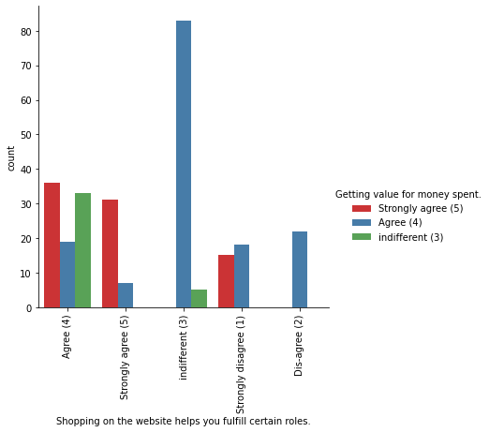
Bi-Variate Analysis Graphs.
Most of our respondents agree that shopping on the websites helps to fulfill certain roles and also that they are getting value for money spent.

Slide 29
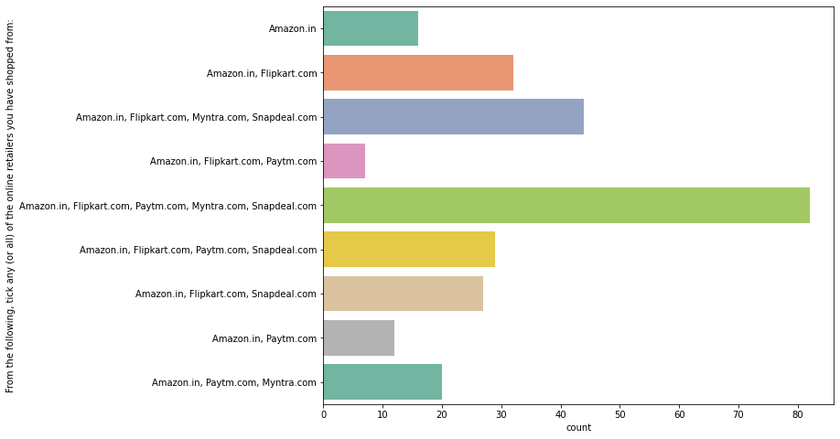
Uni-Variate Analysis Graphs.
Most of the Customers have shopped from all of the following online retailers ("Amazon.in","Flipkart.com","Paytm.com","Myntra.com","Snapdeal.com").

Slide 30
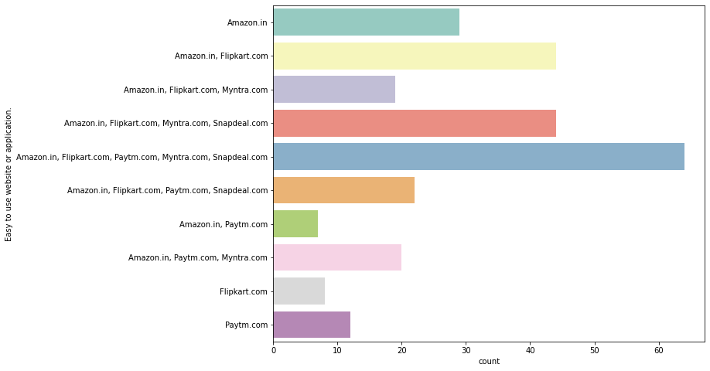
Uni-Variate Analysis Graphs.
Most respondents find all the websites("Amazon","Flipkart","Paytm","Myntra","Snapdeal") to be easy to use.

Slide 31
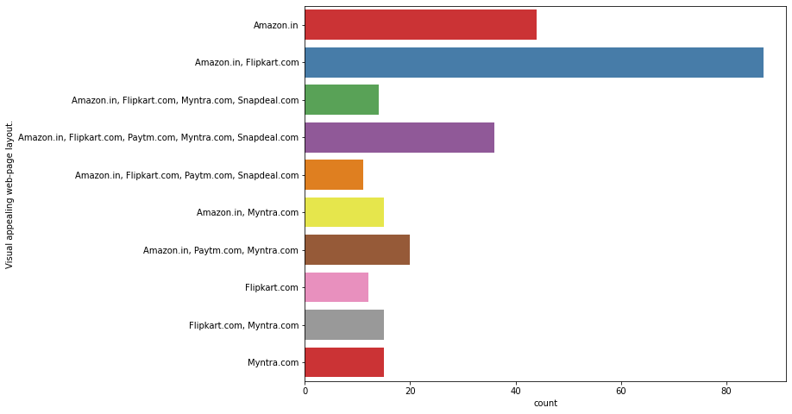
Uni-Variate Analysis Graphs.
Amazon.in, Flipkart.com have the most Visual appealing web-page layout.Followed by Snapdeal.com.

Slide 32
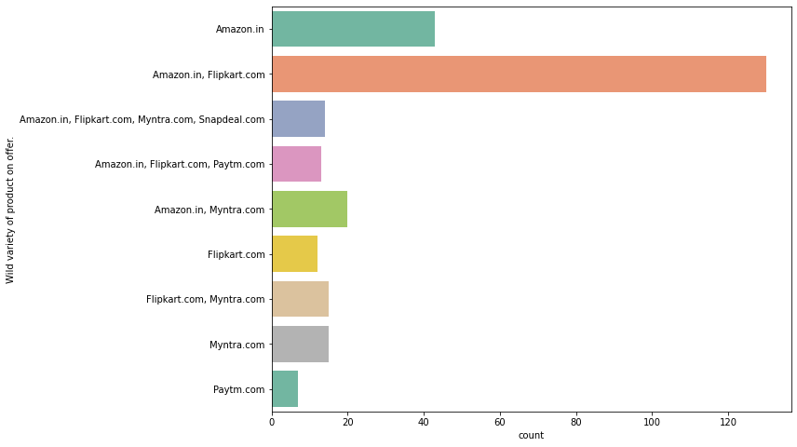
Uni-Variate Analysis Graphs.
Amazon.in, Flipkart.com have a wide variety of products to offer, followed by snapdeal.com and myntra.com. Lastly, Paytm.com

Slide 33
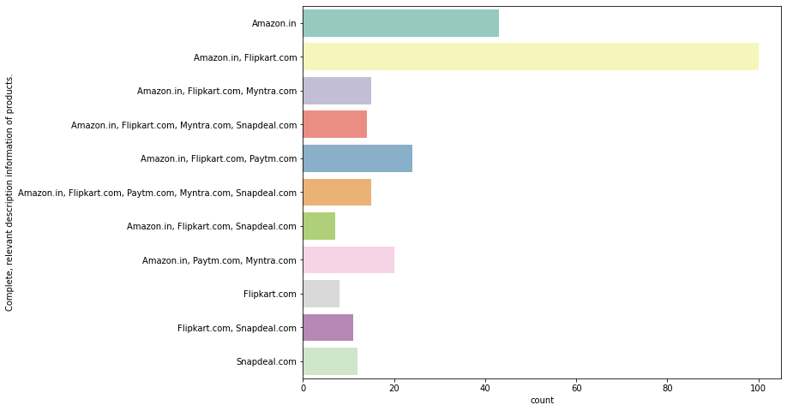
Uni-Variate Analysis Graphs.
It is observed that Amazon.in, Flipkart.com show Complete, relevant description information of products

Slide 34
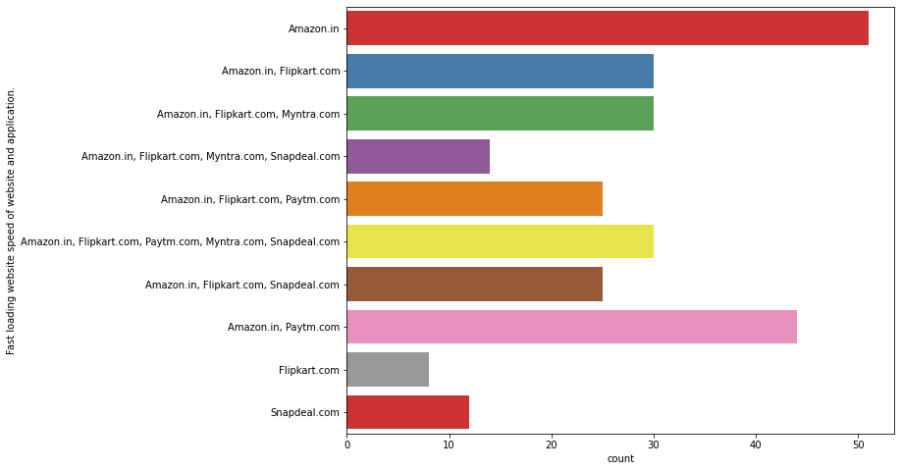
Uni-Variate Analysis Graphs.
It is observed that Amazon.in has the Fast loading website speed of all other websites and applications."Paytm" followed by "Flipkart.com". Slowest website is the "Snapdeal.com".

Slide 35
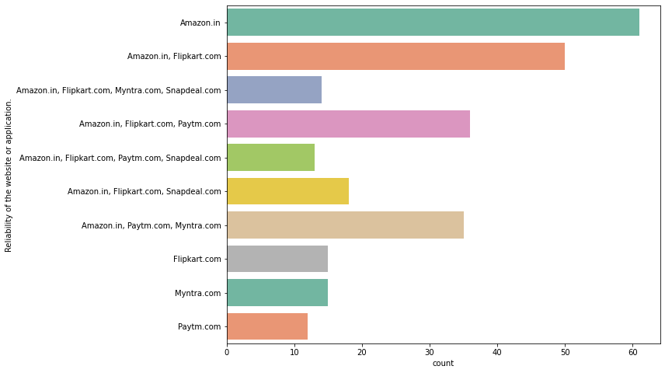
Uni-Variate Analysis Graphs.
It is observed that Amazon.in is the most reliable. Followed by Flipkart.com, Paytm.com, and Myntra.com

Slide 36
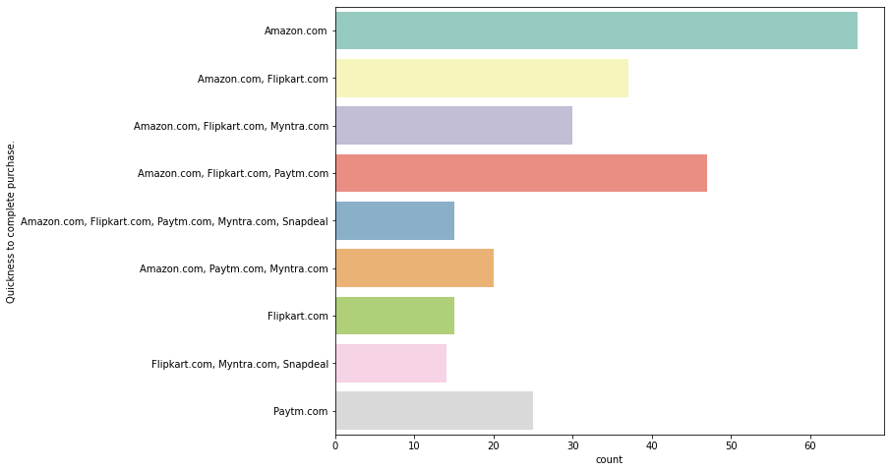
Uni-Variate Analysis Graphs.
It is observed that Amazon.in, Flipkart.com, Paytm.com show Quickness to complete purchase.

Slide 37
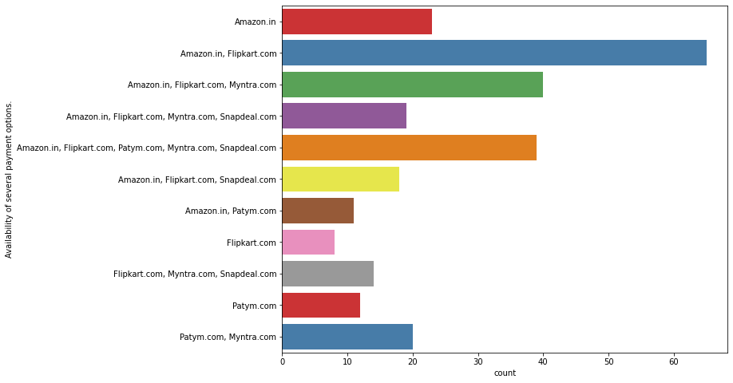
Uni-Variate Analysis Graphs.
Again, Amazon.in, Flipkart.com have the most Availability of several payment options.

Slide 38
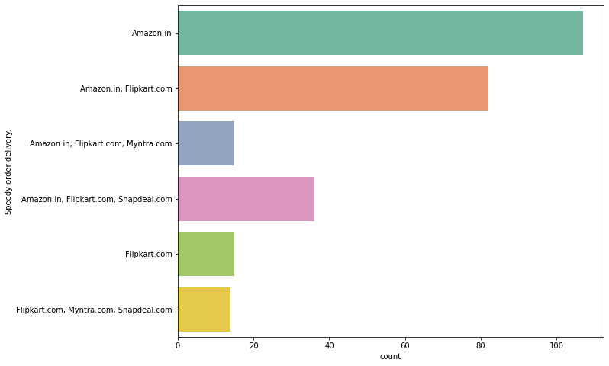
Uni-Variate Analysis Graphs.
We can see that "Amazon.com" delivers the product fastly followed by the "Flipkart.com"

Slide 39
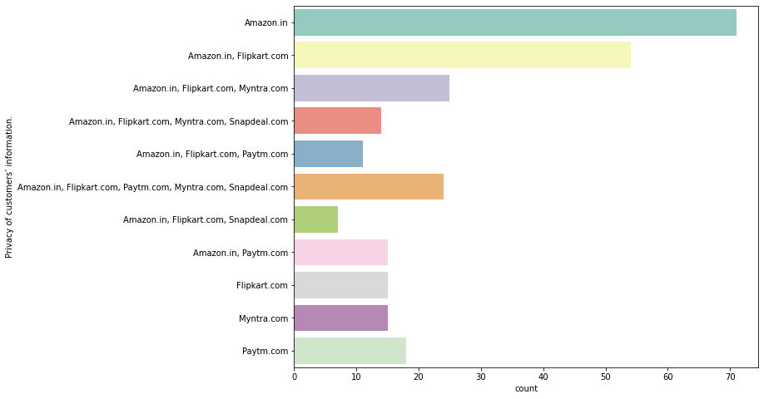
Uni-Variate Analysis Graphs.
It is observed that Amazon.in got the highest in Privacy of customers’ information. Followed by Flipkart.com and Paytm.com

Slide 40
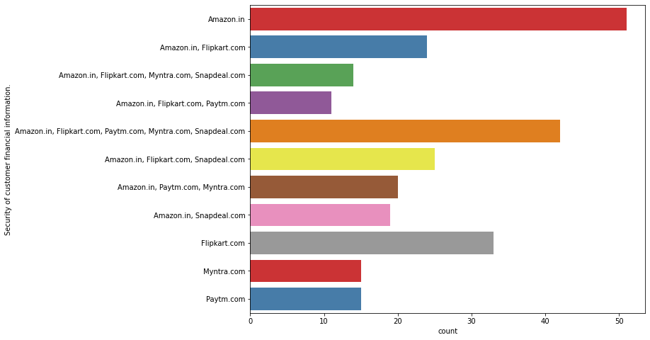
Uni-Variate Analysis Graphs.
Amazon.in, Flipkart.com, Paytm.com, Myntra.com, Snapdeal.com all ranked high in Security of customers' financial information.

Slide 41
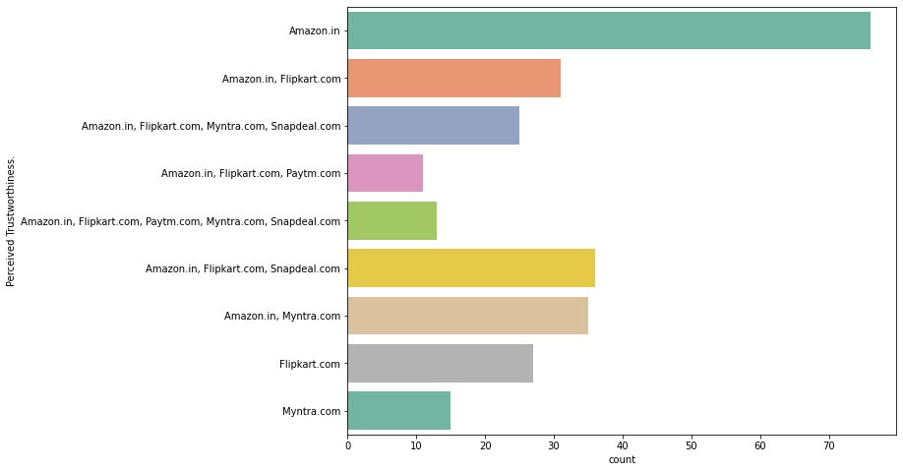
Uni-Variate Analysis Graphs.
It is observed that Amazon.in, Flipkart.com had ranked high in percieved trustworthiness, followed by snapdeal.com and myntra.com

Slide 42
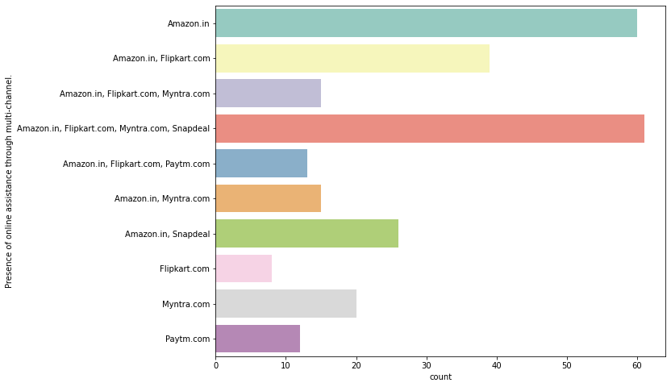
Uni-Variate Analysis Graphs.
Amazon.in, Flipkart.com, Myntra.com, Snapdeal.com had Presence of online assistance through multi-channel.

Slide 43
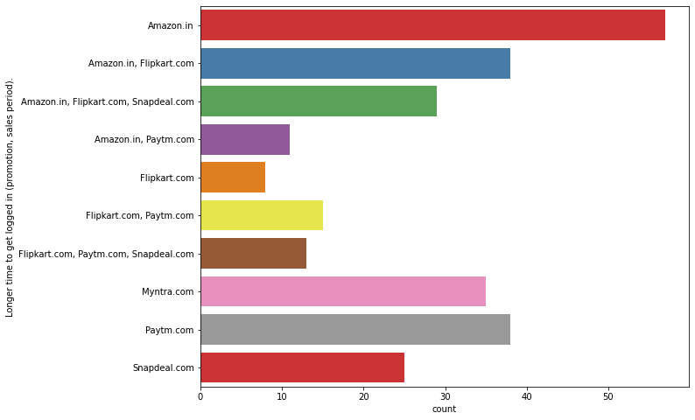
Uni-Variate Analysis Graphs.
It is observed that Amazon.in, Paytm.com, Myntra.com took Longer time to get logged in (promotion, sales period).

Slide 44
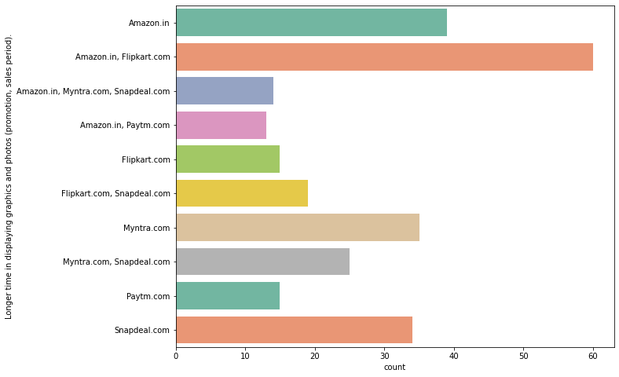
Uni-Variate Analysis Graphs.
Amazon.in and Flipkart.com showed the highest in Longer time in displaying graphics and photos (promotion, sales period).

Slide 45
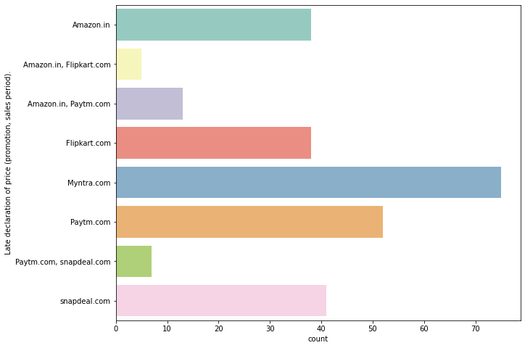
Uni-Variate Analysis Graphs.
Late declaration of price (promotion, sales period). was observed in Myntra.com followed by Paytm.com & Snapdeal.com

Slide 46
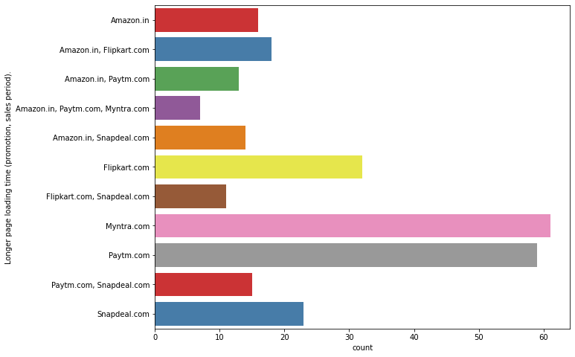
Uni-Variate Analysis Graphs.
Longer page loading time (promotion, sales period). was observed in Myntra.com & Paytm.com

Slide 47
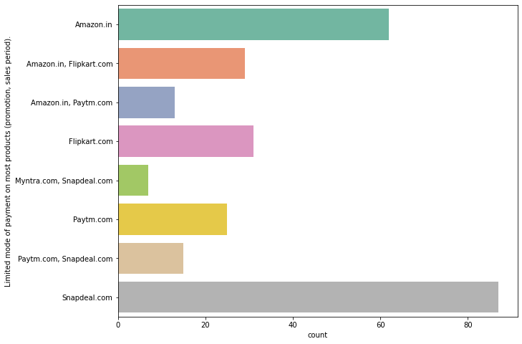
Uni-Variate Analysis Graphs.
As per our respondents, Snapdeal.com had Limited mode of payment on most products (promotion, sales period). Followed by Amazon.in and Flipkart.com

Slide 48
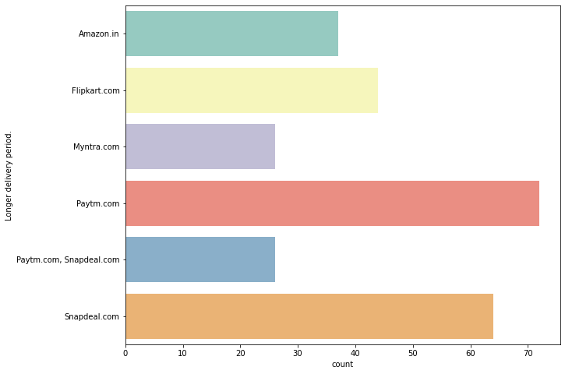
Uni-Variate Analysis Graphs.
According to the chart above, Longer delivery period was observed inSnapdeal.com & Paytm.com.

Slide 49
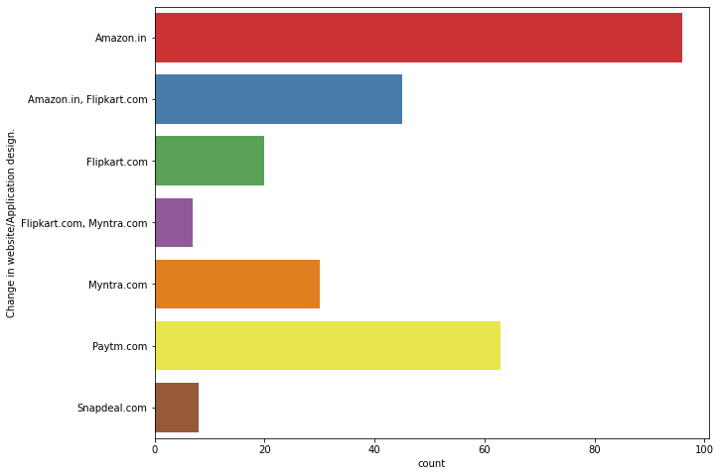
Uni-Variate Analysis Graphs.
According to the respondents, changes to app design took place in Amazon.in and Paytm.com

Slide 50
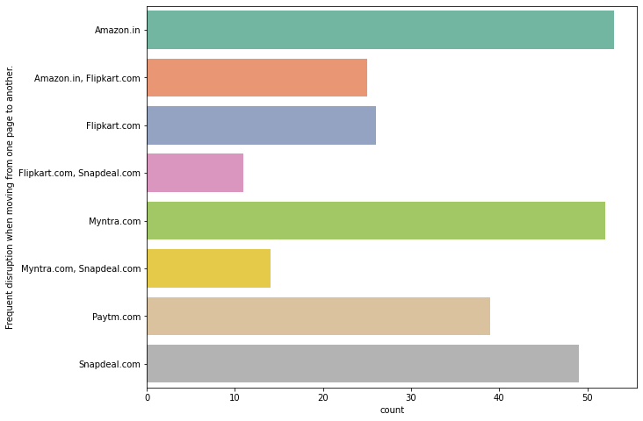
Uni-Variate Analysis Graphs.
Frequent disruption when moving from one page to another was found in Amazon.in, Myntra.com, Snapdeal.com.

Slide 51
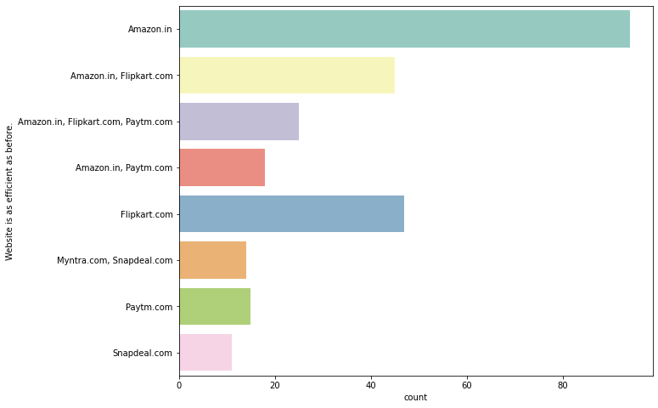
Uni-Variate Analysis Graphs.
It is observed that Amazon.in has remained as efficient as before according to our respondents. Snapdeal.com has no remained as efficient as before.

Slide 52
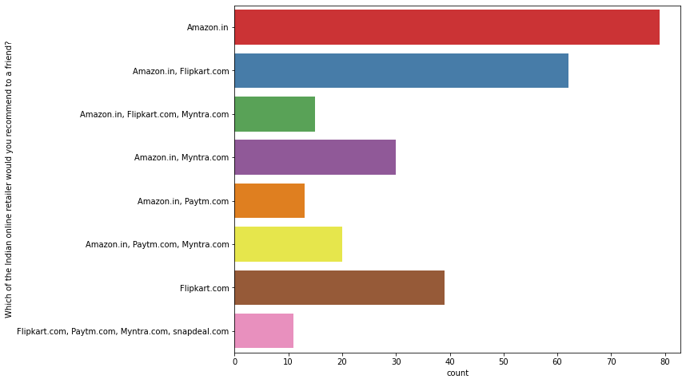
Uni-Variate Analysis Graphs.
We can see that mostly people are recommending "Amazon.com" & "Flipkart.com" to others. Least recommended website is "Paytm" & "Snapdeal".

Slide 53
Results.
After Plotting all the graphs for each column in the jupyter notebook, and plotting more graphs for bivariate analysis we got the following results:
Most of the customers are females belonging to the age group 20-50 years of age.
Most of our respondents use Mobile Internet to access the online retail store.
Most of our respondents have WIndows as their operating system.
The main way to get into the online shopping platform for first timers was through search engines. After that the respondents once again preferred to visit the online shopping platform through search engines.
The preferred mode of payment for our respondents is through DEBIT/CREDIT cards.

Slide 54
Results.
Most of our respondents agree and strongly agree that the content of the website must be easily to read, similar product information of related products must be provided by the online retail store, there must be clarity regarding the Product Information and the Seller’s Information.
The respondents also agree that the website of the online shopping retailer or e-retailer must have a user friendly interface, good loading and processing speed, easy navigation & convenient payment methods.
The respondents also agree that the online shopping retailer must have customer empathy, must guarantee the customer’s privacy, must give timely fulfillment of orders, must be trustworthy, must provide various channels for filing responses.
Respondents also expect the online shopping platform to have a good returns & replacement policy, the quality of the website must be satisfactory, customers must be provided with benefits and discounts, and access to loyalty programs.

Slide 55
Results.
They also agree to providing User trust, Products in several categories, Relevant product information,satisfaction in quality information, Net Benefit Satisfaction & Monetary Savings derived from shopping online.
The respondents also agree that shopping online gives them a sense of adventure, helps enhance their social status, gives them a sense of gratification, gives them a feeling of Role Fulfillment and gives them their Money’s Worth.
Compared to other online shopping platforms, AMAZON.IN and FLIPKART.COM are most heard of and have many benefits rather than drawbacks.
On the other hand, PAYTM.COM, MYNTRA.COM & SNAPDEAL.COM have may drawbacks and are less frequently used than other the online shopping platforms.

Slide 56
Conclusion.
From the results we can conclude that,
There is high customer retention and satisfaction in:
Amazon.in
Flipkart.com
There is a high risk of customer churn in:
Myntra.com
Snapdeal.com
Paytm.com
When customers are satisfied with a company or service, there is a high possibility that they will share their experience with other people (other customers) and recommend the services of said company. Therefore, it is very important for E-commerce retailers to take into account the customer satisfaction because this will help retain customer loyalty as well as attract new potential customers.

